Slide 1
Attention Is All You Need
by Vaswani et al. (2018, NeurIPS)
Mathematics for Deep Learning Seminar
Anil kumar ES
s8anerap@stud.uni-saarland.de
01.July.2019

Slide 2
Outline
Seq2Seq and Attention
Challenges in recurrent models
Prior solutions and weakness
Deep dive into Transformer Network(TN)
Model Architecture
Self-attention
Multi-Head Attention
Why self-attention?
Results and comparison
Conclusion
Key takeaways

Slide 3
Recommended readings and credits
Main Paper
jalammar blog
google.ai

Slide 4
seq2seq
source: jalammarblog
Notes:
In neural machine translation, a sequence is a series of words, processed one after another. The output is, likewise, a series of words

Slide 5
Seq2Seq
source: jalammarblog
Notes:
- Seq2seq: take input seq and outputs seq of another items
Eg. NMT, goal: translate sentence from language to another language. In other words…
Model is composed of an encoder and a decoder.
- The encoder processes each word in the input sequence, it compiles the information and it captures into a vector (called the context).
After processing the entire input sequence, the encoder send the context over to the decoder, which begins producing the outputs sequentially

Slide 6
Problem with RNN based seq2seq model
Difficult to capture long term dependencies
[Hochreiter 1991 and Bengio, et al. 1994]
Does it help to capture long term dependencies if the model uses all encoded hidden states during decoding?
Yes, that is attention!! Attention allows the model to focus on the relevant parts of the input sequence as needed
[Bahdanau et al., 2014 and Luong et al., 2015]

Slide 7
Introducing Attention
source: jalammarblog
Notes:
An attention model differs from a classic sequence-to-sequence model in two main ways:
First, the encoder passes a lot more data to the decoder. Instead of passing the last hidden state of the encoding stage, the encoder passes all the hidden states to the decoder
Second, an attention decoder does an extra step before producing its output. In order to focus on the parts of the input that are relevant to this decoding time step, the decoder does the following:
Look at the set of encoder hidden states it received – each encoder hidden states is most associated with a certain word in the input sentence
Give each hidden states a score
Multiply each hidden states by its softmaxed score, thus amplifying hidden states with high scores, and drowning out hidden states with low scores

Slide 8
Attention computation
source: jalammarblog
Notes:
This scoring exercise is done at each time step on the decoder side.

Slide 9
Decoding with attention
source: jalammarblog
Notes:
The attention decoder RNN takes in the embedding of the <END> token, and an initial decoder hidden state.
The RNN processes its inputs, producing an output and a new hidden state vector (h4). The output is discarded.
Attention Step: We use the encoder hidden states and the h4 vector to calculate a context vector (C4) for this time step.
We concatenate h4 and C4 into one vector.
We pass this vector through a feedforward neural network (one trained jointly with the model).
The output of the feedforward neural networks indicates the output word of this time step.
Repeat for the next time steps

Slide 10
Attention heatmap
What is attended when? - attention heatmap of output over inputs
source: jalammarblog
Notes:
This is another way to look at which part of the input sentence, we’re paying attention to at each decoding step

Slide 11
Challenges with RNN based model
Recurrent computation is sequential, which inhibits parallelization within training examples
Memory constraints limit how much parallelization can take place across training examples
Number of operations(path length) required to translate an input word at any arbitrary position to output is O(n), n is sequence length
Notes:
Prevent parallelization within the training examples( have to wait to for prev hidden state vector computation to finish to compute next hidden vector)
Has to remember lot of information if the sentences are long and hence memory intensive, thus small batch size

Slide 12
Suggested solutions and weakness
Seq2seq: different approach
ConvS2S
ByteNet
All model use CNN as building blocks
Reduces sequential computation
But, path length still grows with distance between positions
This makes it difficult to learn dependencies between distant positions
Notes:
- All models convolutional neural networks as basic buildingblock, computing hidden representations in parallel for all input and output position
In these models,the number of operations required to relate signals from two arbitrary input or output positions growsin the distance between positions,
linearly -ConvS2S
logarithmically - ByteNet.
This makesit more difficult to learn dependencies between distant positions [11].

Slide 13
Transformer Model
Based solely on attention mechanisms, without any recurrence or convolutions entirely

Slide 14
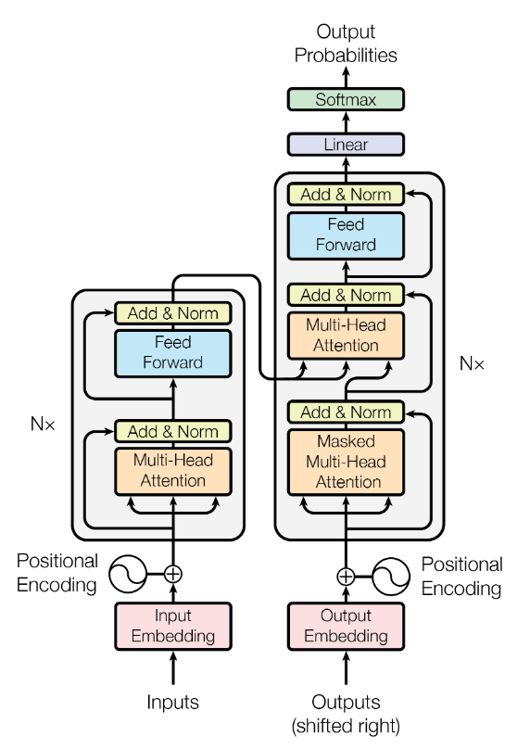
Transformer Architecture
Decoder
Encoder-decoder structure
Encoder: maps an input sequence of symbol representation $X=(x1,…,xn )$ to continuous representations $Z=\left(z1,…,zn \right)$
Decoder: Given $Z$, generates an output sequence of symbols $Y=\left(y1,…,ym \right)$
At each decoding step, model is auto-regressive
Positional encoding adds the positional information of words
Encoder
Notes:
The encoder is composed of a stack of N=6 identical layers, each with two sub-layers: a multi-head self-attention mechanism, and a simple, position-wise fully connected feed-forward network. There is a residual connection around each of the two sub-layers, followed by layer normalization.
The decoder is also composed of a stack of N=6 identical layers. The decoder inserts a third sub-layer, which performs multi-head attention over the output of the encoder stack. The self-attention sub-layer in the decoder stack has masking to prevent positions from attending to subsequent positions.

Slide 15
Encoder
Composed of a stack of N = 6 identical layers
Each layer has 2 sub-layers
Multi-Head self-attention mechanism and position-wise fully connected FFN
Residual connections around each of sublayer followed by layer Normalization
Note: output dimensions must be same(d_{model}=512)
Encoder

Slide 16
Decoder
Decoder
Composed of a stack of N = 6 identical layers
Each layer has 3 sub-layers
Multi-Head self-attention mechanism, position-wise fully connected FFN and MHA over output of encoder stack
Employed masking at the MHA self-attention mechanism to prevent positions from attending subsequent positions.
Residual connections around each of sublayer followed by layer Normalization

Slide 17
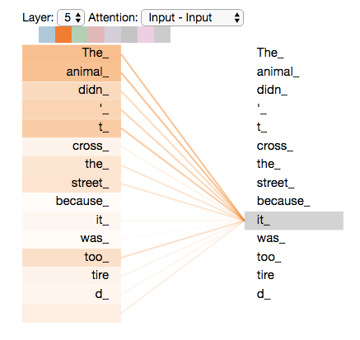
Self-attention intuition
”The animal didn't cross the street because it was too tired”
source: jalammarblog

Slide 18
Attention in Transformer
Query, key and value → vectors describing different representations of a symbol(linear projections of symbols)
Attention: mapping a query and a set of key-value pairs to an output

Slide 19
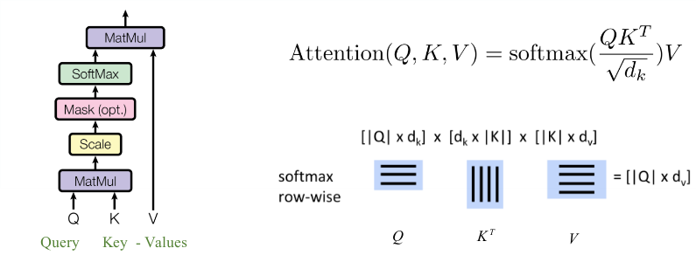
Scaled Dot-Product Attention
Normalization is done over each row of resultant matrix → weights
Scaling is done to prevent softmax input from being very large magnitude, which in turn prevents the gradients from being very small.
Output is computed as a weighted sum of the Values
Weight is computed by a compatibility function with Query and Corresponding Key

Slide 20
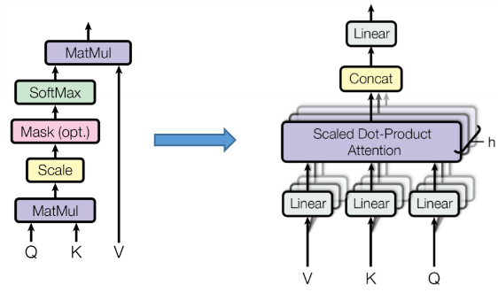
Multi-Head Attention
Scaled Dot-Product Attention Multi-Head Attention
Jointly attend to information from different representation
subspaces at different positions

Slide 21
Position-wise FFN and Positional Encoding
Make use of the order of the information
Inject information about relative or absolute position

Slide 22
Dissecting the model for small sequence example

Slide 23
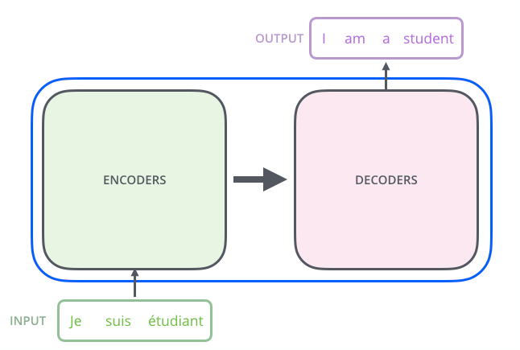
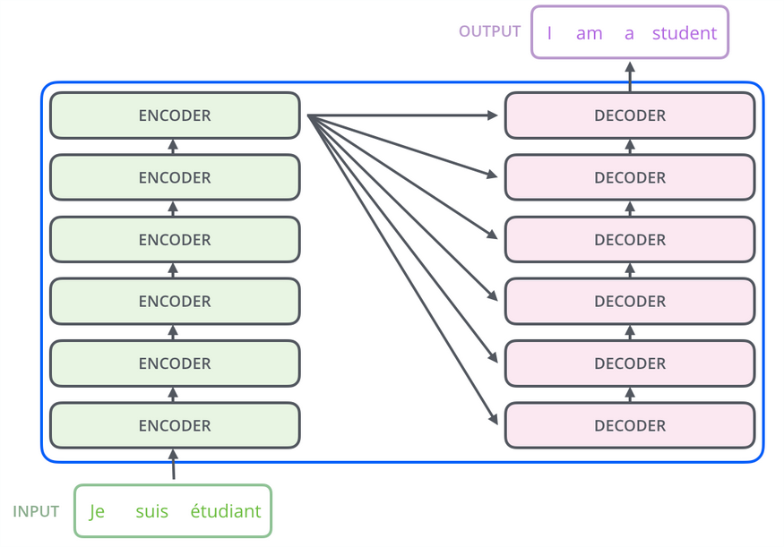
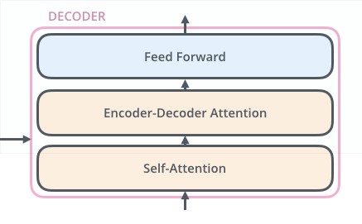
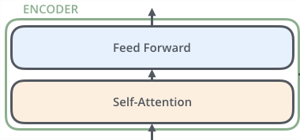
High-level architecture
source: jalammarblog
Notes:
Big arrows → representation
Small arrows →information flow

Slide 24
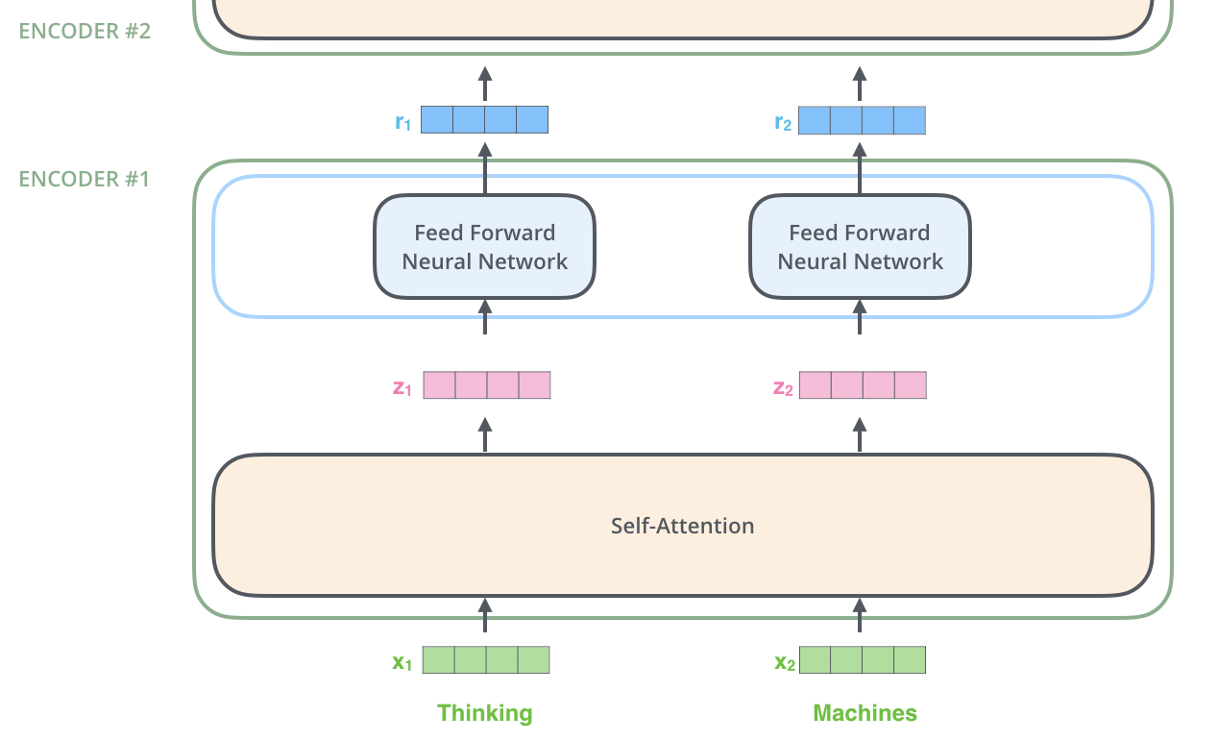
Encoding
source: jalammarblog

Slide 25
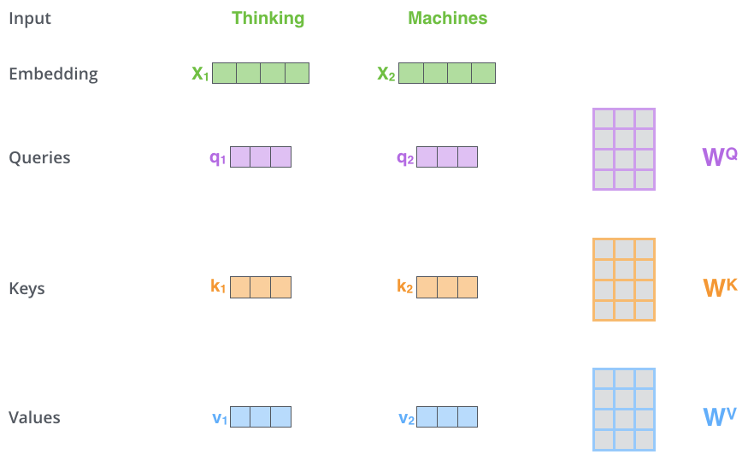
Self-attention: step1
source: jalammarblog
Notes:
Multiplying x1 by the WQ weight matrix produces q1, the "query" vector associated with that word. We end up creating a "query", a "key", and a "value" projection of each word in the input sentence

Slide 26
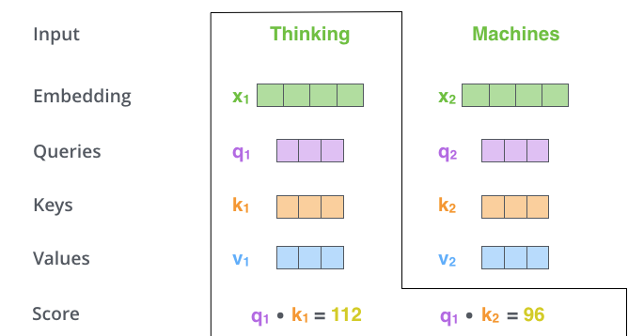
Self-attention: step2
source: jalammarblog

Slide 27
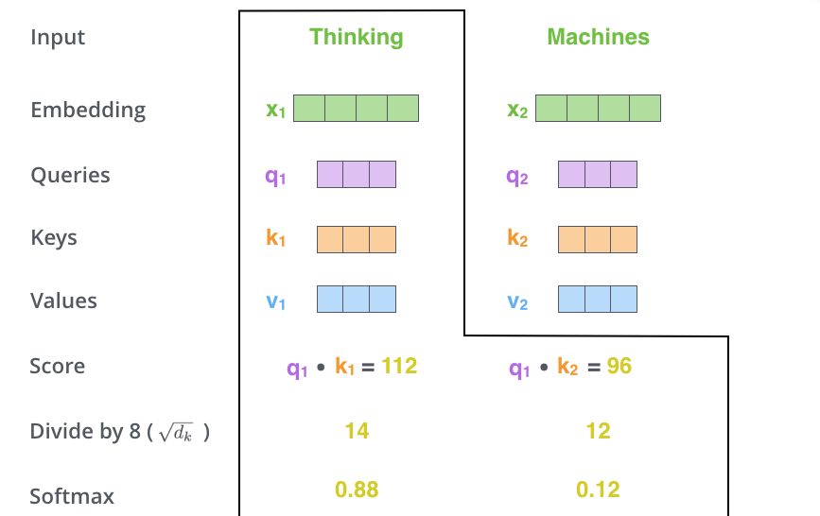
Self-attention: step3
source: jalammarblog

Slide 28
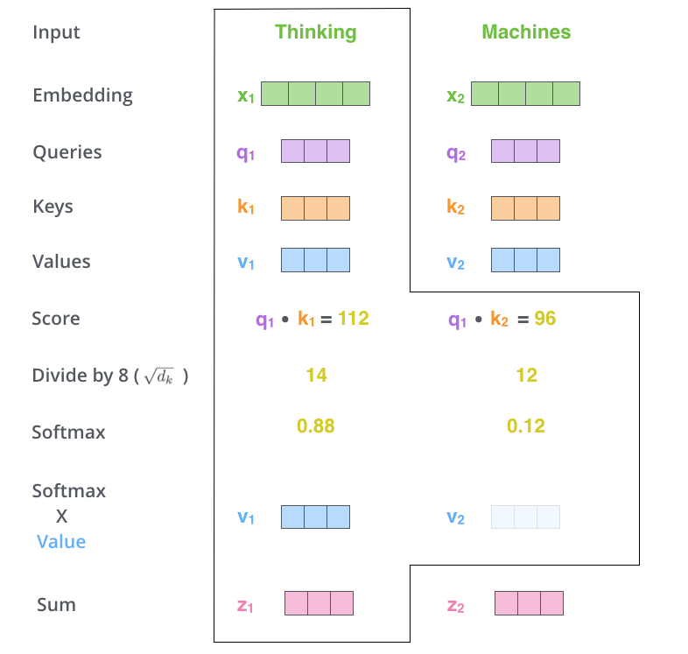
Self-attention: step4
source: jalammarblog

Slide 29
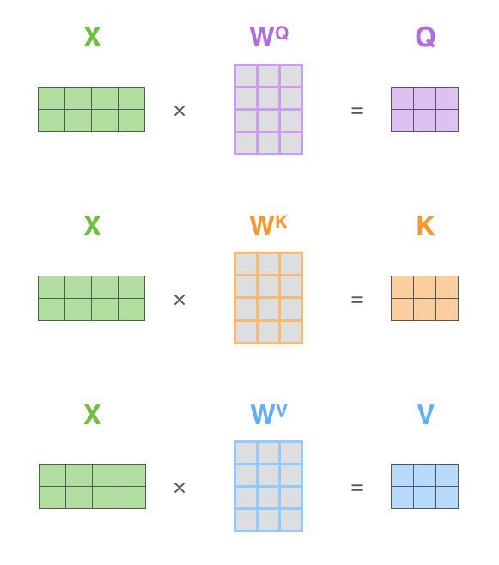
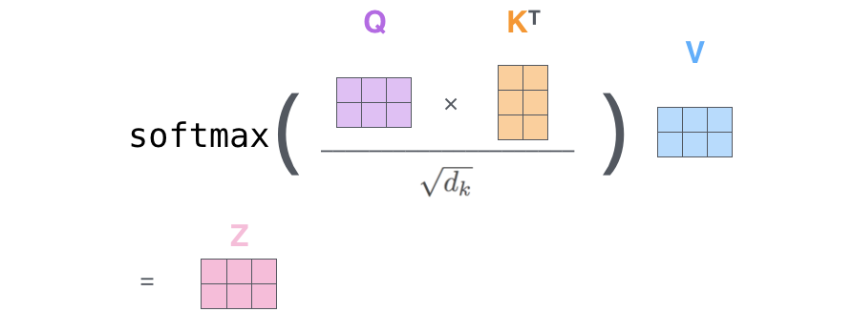
Matrix calculation of Self-Attention
This matrix calculations is very efficient on GPUs
source: jalammarblog

Slide 30
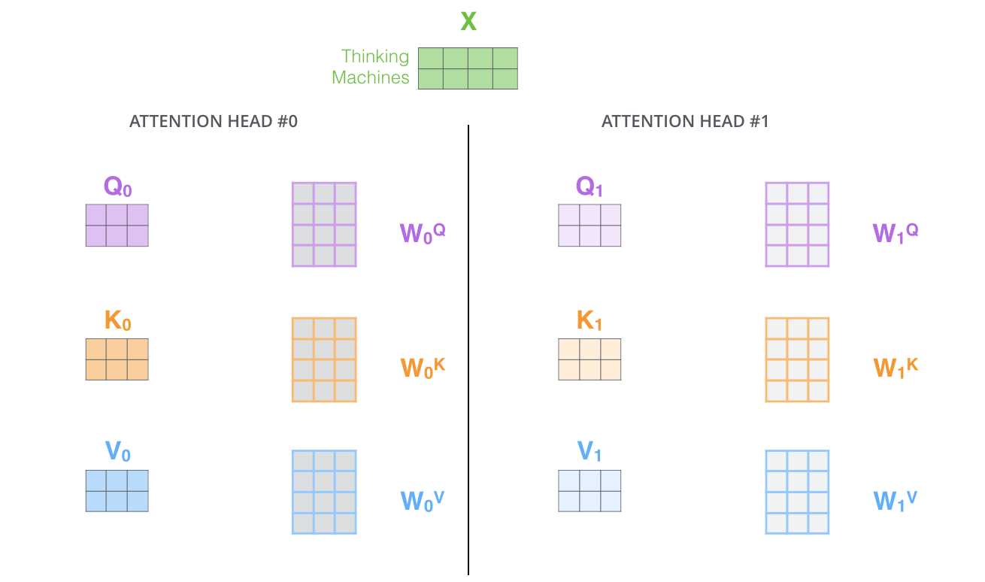
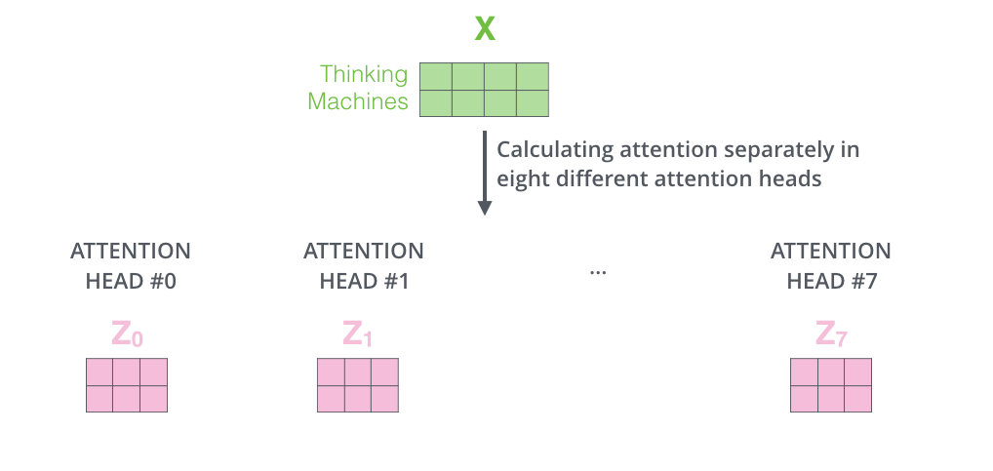
Multi-Headed representations
source: jalammarblog

Slide 31
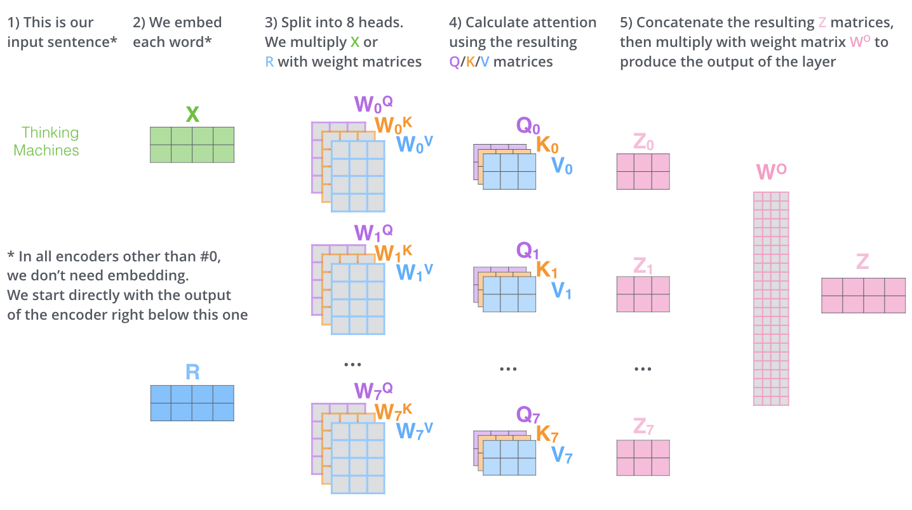
Multi-headed self-attention pipeline
source: jalammarblog

Slide 32
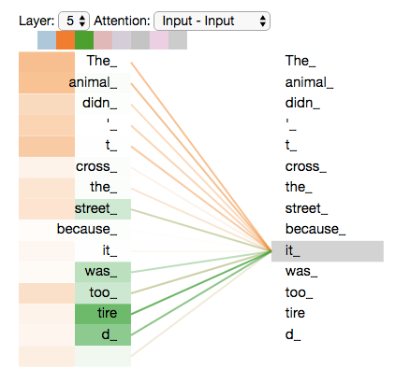
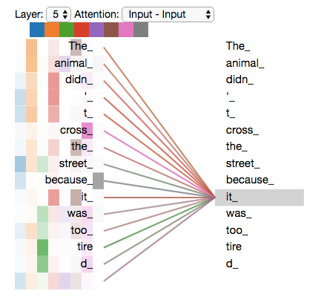
MHA Visualization
source: jalammarblog
Notes:
Different heads capture different features or semantics for each word which will be useful for accurate translation

Slide 33
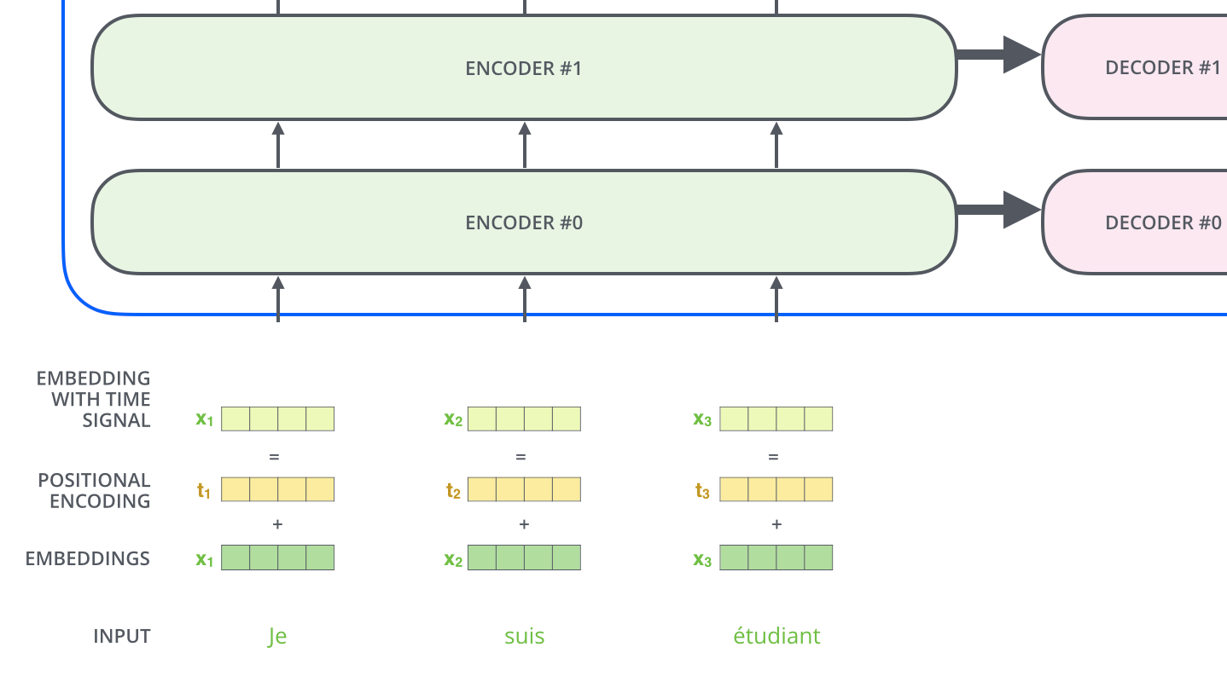
Positional encoding

Slide 34
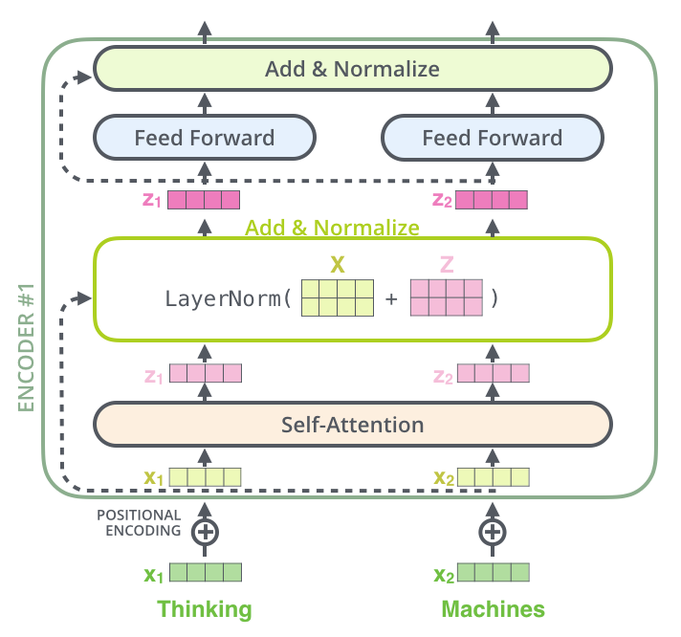
Residuals
source: jalammarblog

Slide 35
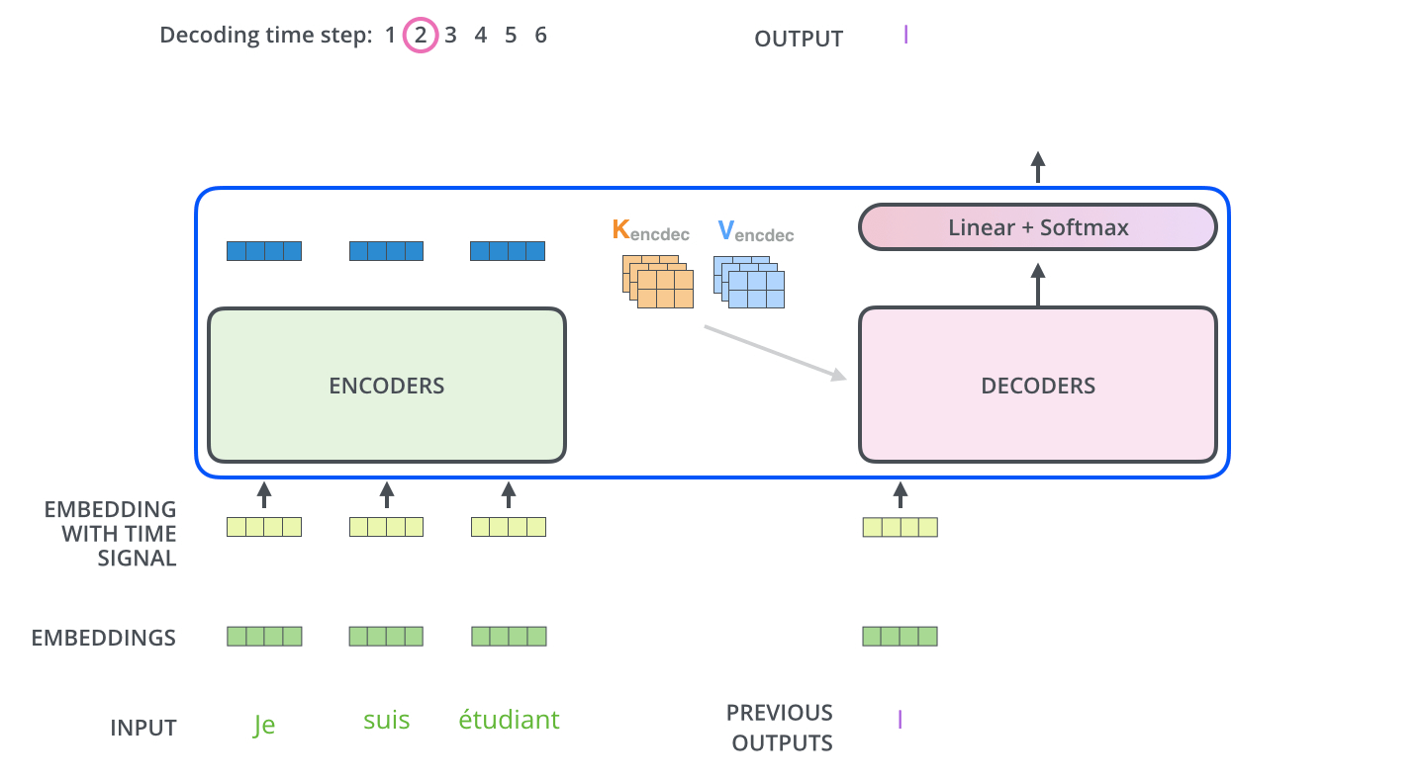
Decoding
source: jalammarblog

Slide 36
Translation using Transformer
source: google.ai

Slide 37
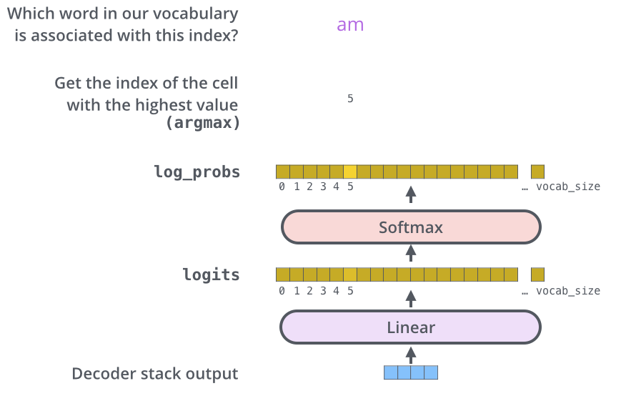
Final layer and Softmax

Slide 38
Why Self-attention?
Reduced complexity
N → sequence length
d → representation dimension
K → kernel size of convolutions
r → size of neighborhood in restricted self-attention

Slide 39
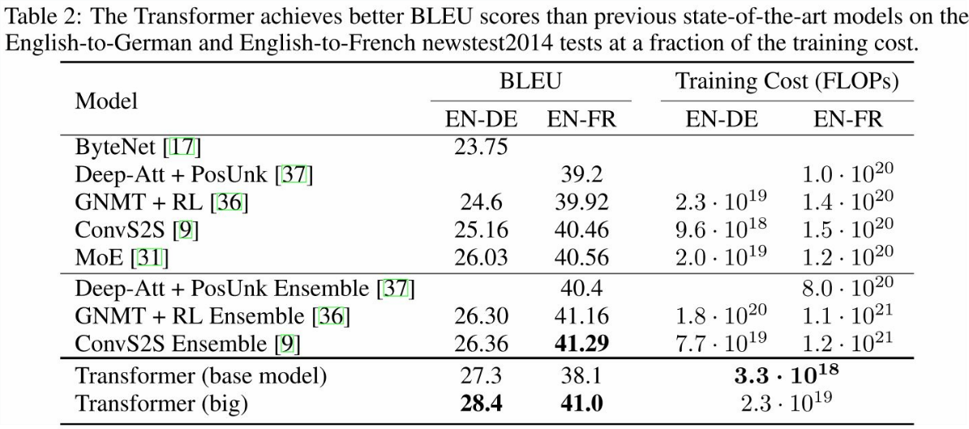
Results

Slide 40
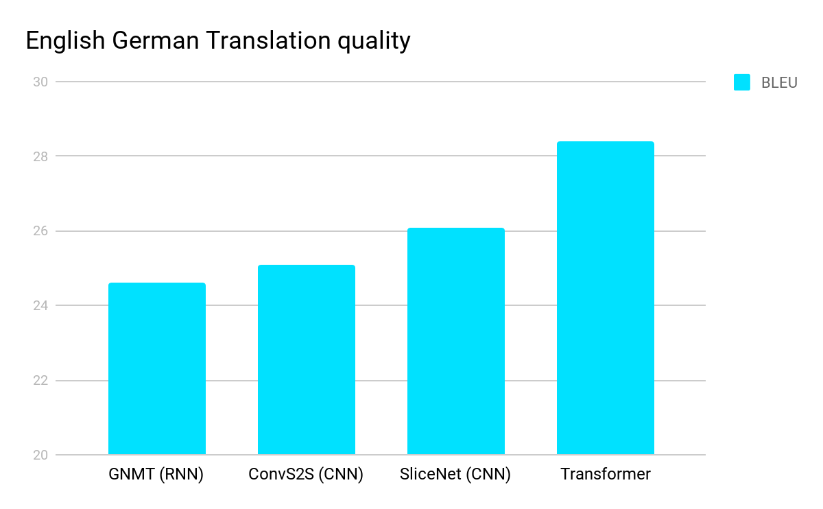
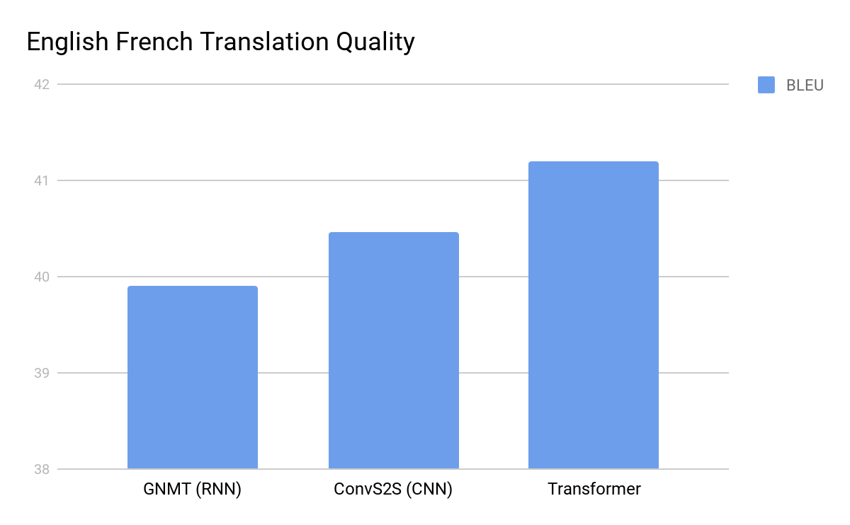
Results
source: google.ai
Notes:
BLEU - Bilingual Evaluation Understudy, is a metric for evaluating a generated sentence to a reference sentences
BLEU scores (higher is better) of single models on the standard WMT newstest2014 English to German translation benchmark.
BLEU scores (higher is better) of single models on the standard WMT newstest2014 English to French translation benchmark.

Slide 41
Training and Decoding
ADAM optimizer with learning rate proportional to (step-0.5)
Dropout during training at every layer just before adding residual
Label smoothing
Auto-regressive decoding with beam search
Notes:
Label smoothing: Label-smoothing is the practice of assigning each class some weight, instead of assigning the ground truth label the full weight. As the network will overfit less on the training labels, it should be able to generalise better, which is is a similar practice as using L2 regularisation

Slide 42
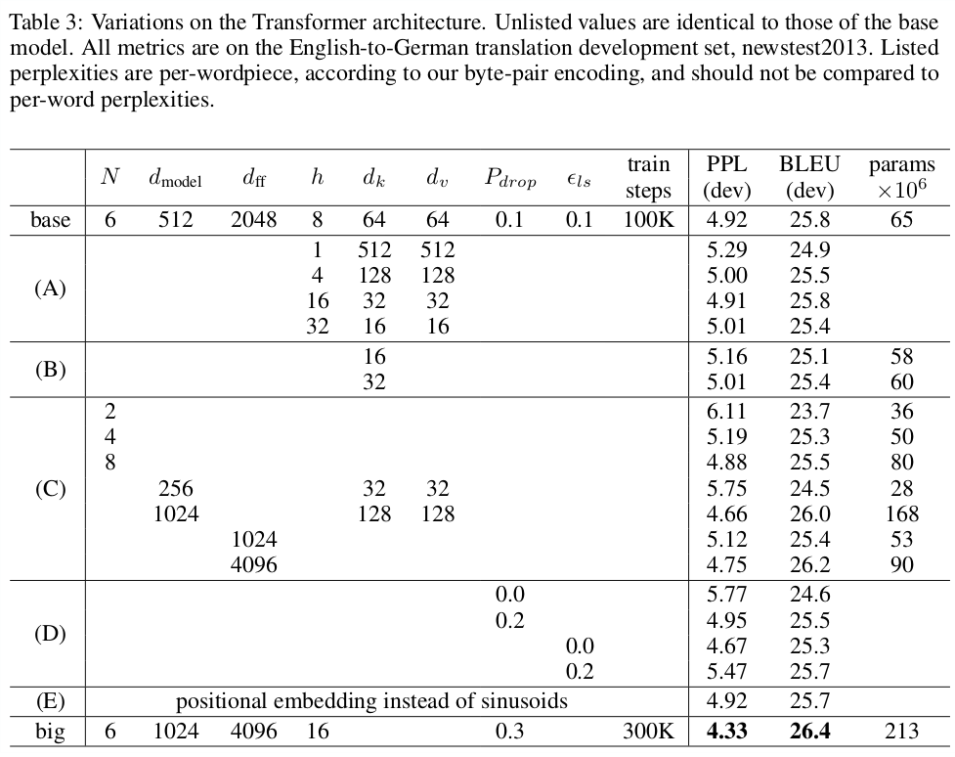
Ablations

Slide 43
Conclusion
First transduction model based entirely on attention
Transformer can be trained faster then RNN and CNNs for translation tasks
Achieved new SOA for translation tasks
Parallelized computations - efficient and accurate
Research directions:
Handling large sequences
Making generation less sequential
Extending transformer to image, video and audio domain

Slide 44
Key takeaways
Transformer is the best model for translation tasks.
Can be applied to other problems
Combinatorial optimization problems
Like Travelling Salesman Problem(Graphs of node size 20, 50, 100) [Kool et. al 2019]
Inefficient if sequence length>dimension

Slide 45
References
https://arxiv.org/abs/1706.03762.
http://mlexplained.com/2017/12/29/attention-is-all-you-need-explained/
https://jalammar.github.io/illustrated-transformer/
http://nlp.seas.harvard.edu/2018/04/03/attention.html
https://ai.googleblog.com/2017/08/transformer-novel-neural-network.html
https://openreview.net/forum?id=ByxBFsRqYm
https://arxiv.org/abs/1409.0473
https://arxiv.org/abs/1508.04025

Slide 46
Thank you for your Attention!!

